Slide 1
Design patterns
C# edition
Overview and examples

Slide 2
The main purpose of design patterns:
To do the thing in the only possible way
To organize, reuse, and standardize the code
Major advantage:
Simplifies the usage of the code, makes it more organized, and improves (allow) its extendibility
Major disadvantage:
You need the knowledge to use and read them. Additional initial effort

Slide 3

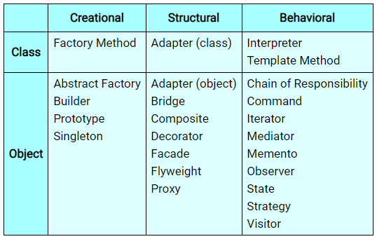

Types of design patterns:
Beyond this general classification there are also practices or smaller structures which can also be treated as patterns (e.g., DTO workflow, IDisposable pattern, testing and architecture patterns)

Slide 4
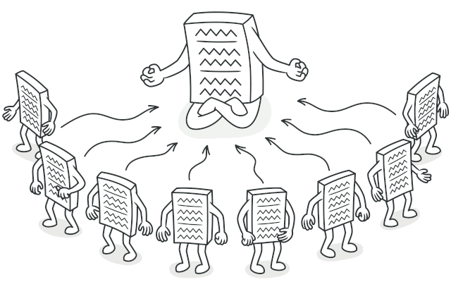
1. Singleton
CREATIONAL
Characteristic
Ensure to create and reuse always the only one instance of some object, class (e.g., Controller or parts of other design patterns: like abstract factory, factory method, builder, strategy, state…), or resources (e.g., file with logs and other information, database, cached data - which initialization is repetitive and pretty expensive).

Slide 5
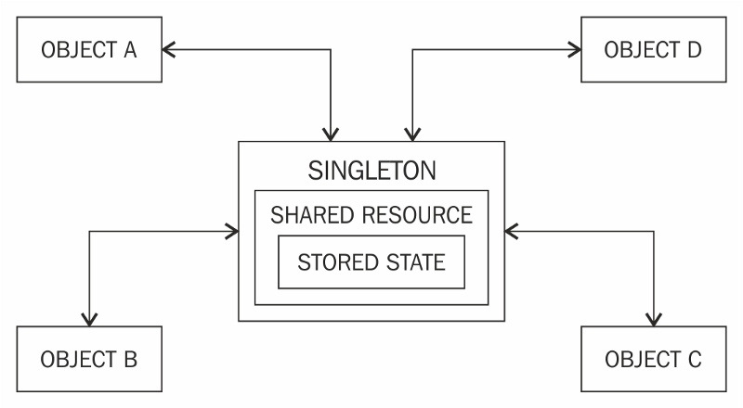
The purpose:
Controls occurrences: When you need to have only 1 instance of some object to not mess with the context
(e.g., database) or to not create unnecessary duplicates (many files, many instances).
Caching the instance: To prevent initializing the same object all the time, again and again, to avoid unnecessary
overhead and to improve the performance.
Controls access to shared resource (e.g.: public static) from other places
to aggregate and synchronize data.
Singleton is treated as a gatekeeper.

Slide 6
Benefits and costs of using:
Pros:
Cons:
+ Creation of instance is fast and easy: once made effort, to set up creation of an instance properly, it is ready to reuse (automatically) later. You do not need to think about it any further.
+ Encapsulation of the code: The object initializa-tion is hidden and safe from modifications.
+ Safe and economic: Because preventing creating multiple instances of some class.
+ The instance is easily accessible: Usually it is public and static object called „Instance” or re- quested on demand by „GetInstance()” method.
- Difficult to test: A Singleton might cause issues for writing testable code if the object and the methods associated with it are so tightly coupled that it becomes impossible to test with-out writing a fully-functional class dedicated to the Singleton.
- Singletons create hidden dependencies: As the Singleton is readily available throughout the code base, it can be overused. And because its reference is not completely transparent while passing to different methods, it becomes difficult to track.
- That’s why singleton is considered by many developers as antipattern (if overused or misused).

Slide 7
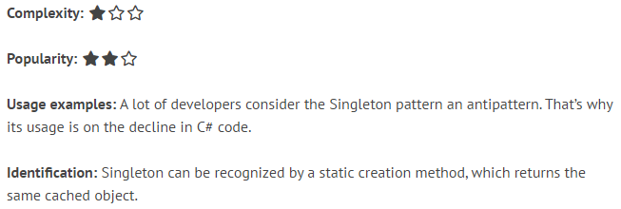
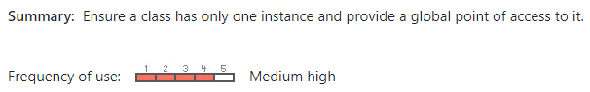
Resources:
Singleton is very easy design pattern,
which does not require any complex structure of folders, inheritance or logic flow. It can be even „one liner”.
https://refactoring.guru/design-patterns/singleton/
https://refactoring.guru/design-patterns/singleton/csharp/example/
Singleton design pattern is popular
because it is a universal and pretty
natural way (even if you do not know
this pattern is even existing) how to
control instances of your objects/data
https://dofactory.com/net/singleton-design-pattern/
https://csharpindepth.com/Articles/Singleton/

Slide 8


Slide 9


Life examples:
There are situations when having more than one leader at the same time would cause a chaos and uncertainty. It is clearer to have a single person to be responsible for commanding the team and making life-saving decisions in emergencies.
As an opposition to that, there are also cases when flexibility and having an option to substitute one system component by another one – playing the same role and with similar potential, may save the situation and be more beneficial in long term.

Slide 10

Business cases:
When there is no need to have multiple instances of the main controller / service responsible for the same thing
When the implementation is very heavy and calling it twice (even by an accident) may result in performance issues
User Story:
When a particular part of the application is called the process execution is always taking the same amount of time, even if the calcula- tion was already used. During a code review an architect realized that some internal service is always recreating a heavy setup of an algorithm. This workflow can be improved if the preparation will be loaded once and then reused on demand.

Slide 11



Implementation

Slide 12
Implementations
Returns the cached instance of a selected class (which is singleton) or create a new instance of this class if any instance is not existing yet.
This implementation will create singleton instance on demand (Using such, on-demand, strategy is called „lazy initialization”).
Remember about thread-safe design in the future for
other implementa-tions as well ☺
Lazy initialization (methods):
Thread-safe implementation:
public class SomeSingletonClass
{
private static SomeSingletonClass _instance; // null by default
public static SomeSingletonClass GetInstance()
{
if (_instance == null) // Check if instance is existing
{
_instance = new SomeSingletonClass();
}
return _instance; // Return cached instance
}
private SomeSingletonClass(); // To prevent calling constructor
}
public class SomeSingletonClass
{
private static SomeSingletonClass _instance; private static readonly object padlock = new object();
public static SomeSingletonClass GetInstance()
{
lock (padlock) // Prevent exceptions when many threads wants
{ to paralel access the same resource „_instance”
if (_instance == null)
{
_instance = new SomeSingletonClass();
}
return _instance;
}
}
private SomeSingletonClass(); // To prevent calling constructor
}

Slide 13
Implementation
Initializes instance of some class immediatelly and then return it
when user is asking (new implementations will not be created)
Instant initialization (read-only properties):
public static class SomeSingletonClass // Prevent creating instance of this class from construtor „new”
{
public static ClassToInitialize Instance { get; } = new ClassToInitialize(); // Static read-only property with overriden default value
}
public sealed class SomeSingletonClass // Additional protection („sealed”) to not override this class and create its instance from child class
{
public static SomeSingletonClass Instance { get; } = new SomeSingletonClass(); // Static read-only property with overriden default value
private SomeSingletonClass() { } // Forbid creating instance of this class from constructor(!)
}

Slide 14
Implementation
Initializes instance of some class immediatelly and then return it
when user is asking (new implementations will not be created)
Instant initialization (static constructor):
DIFFERENT TYPES OF CONSTRUCTORS IN C#:
1. Default constructor (parameterless):
public Cat() { } // Parameterless (e.g., EntityFramework require them to be always implemented!)
-------------
2. Custom constructor (with parameters):
public Cat(string name) { } // With parameters
--------------
3. With restricted accessibility:
private Cat() { } // Forbid using constructor of this class(!)
protected Cat() { } // Can call only from children => BabyCat : Cat
----------------
4. Static constructors:
static Cat() { } // Is called only once when class is created
public static class SomeSingletonClass
{
public static readonly ClassToInitialize Instance; // Field
static SomeSingletonClass() // Static constructor
{
Instance = new ClassToInitialize();
}
}

Slide 15
Use cases:
Working with database:
Working with other design patterns:
private DbContext _context = DbContext.GetInstance();
public void Connect()
{
this._context.Connect();
// OR, without private instance field
DbContext.Instance.Connect();
}
var factory = ServiceFactory.GetInstance();
var service = factory.Create(ServicesEnum.Broadcaster);
decimal taxRate = 28.0m;
var strategy = new IncomeAfterTax(taxRate);
var calculationStrategy = Strategy.Instance;
calculationStrategy.SetContext(strategy);
calculationStrategy.Process();

Slide 16

Interactions with other design patterns:
Singleton can be used everywhere with final, concrete implementations

Slide 17

CONVENTION:
Property called “Instance”
Using method called “GetInstance()”

Slide 18
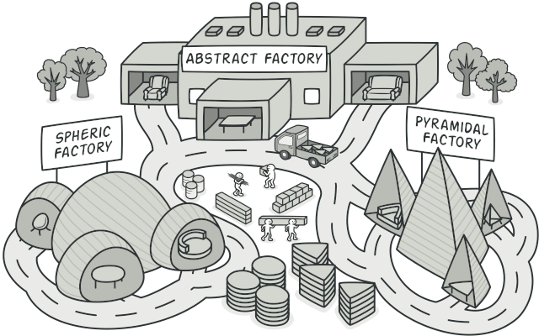
2a. Abstract Factory
CREATIONAL
Characteristic
Simplifies creation of custom or predefined models. The creation process of a specific objects is managed from a single specialized (concrete) factory class. The factory can be used and extended easily for unlimited creation possibilities (following: SOLID Principles).

Slide 19
The purpose:
Easier way to create objects: Wrapping the logic responsible for creating (and usually already customizing and
pre-initializing) defined types of models, so, the developer does not need to re-
member about all of the initialization steps – only using a single method.
Easier to handle models: As a result of introducing Factory architecture, models are inlined and well organized.
It is also easier to find and differentiate specific implementations and base, shared code.
Keeps the architecture clean: Helping to follow Open-Closed Principle (SOLID), because creation of a new model
only extends (updates) an already existing implementation – changing is not needed.
Makes the code look better: Using single statements (usually “Create(xyz)” or “Get(xyz)” methods) are way cleaner,
easier to understand and more elegant to use, than a full, long new() initializations.

Slide 20
Benefits and costs of using:
Pros:
Cons:
+ Usage is simplified: The only thing to do is to get an instance of factory and to use its method with predefined input arguments (type of object to be created by Abstract Factory).
+ Procedurized way of creating new objects.
+ Generic implementation is reducing the code size and improves its maintainability (easier, faster).
+ Good organization of a code: Usually, you are introducing a separate folders structure to keep your concrete factories, and models which can be managed by them.
- Need to handle additional dependency: You need to pass and manage somehow the usage of Factory implementation. Pro- bably Dependency Injection would be required on a high level.
- Introducing more objects: Some people may consider this pattern as an overhead if you have only a few models in your project. Abstract Factory is a full scale change in the project and sometimes it is beneficial to just use Factory Method or to not use any of them at all => by keeping things simple. However, this is rather universal architecture problem.

Slide 21
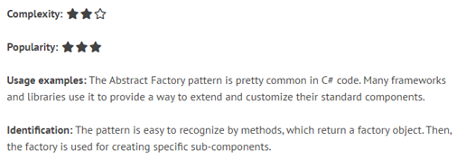
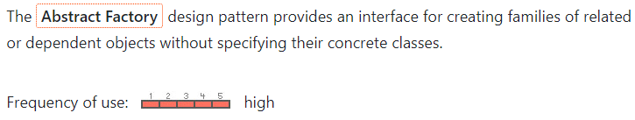
Resources:
https://refactoring.guru/design-patterns/abstract-factory/
https://refactoring.guru/design-patterns/abstract-factory/csharp/example/
https://www.dofactory.com/net/abstract-factory-design-pattern/
https://dotnettutorials.net/lesson/factory-design-pattern-csharp/

Slide 23


Life examples:
Process automation (repetitiveness, easy to handle)
Efficiency (larger quantity + faster production)
Standardization (each outcome is nearly the same)
Normalization (you can compare procedures)
When you cannot reduce procedure into algorithmic steps (e.g., when need to look for an inspiration), or cannot sacrifice the individual footprint (style, interpretation)
the product (by intention) should be unique

Slide 24
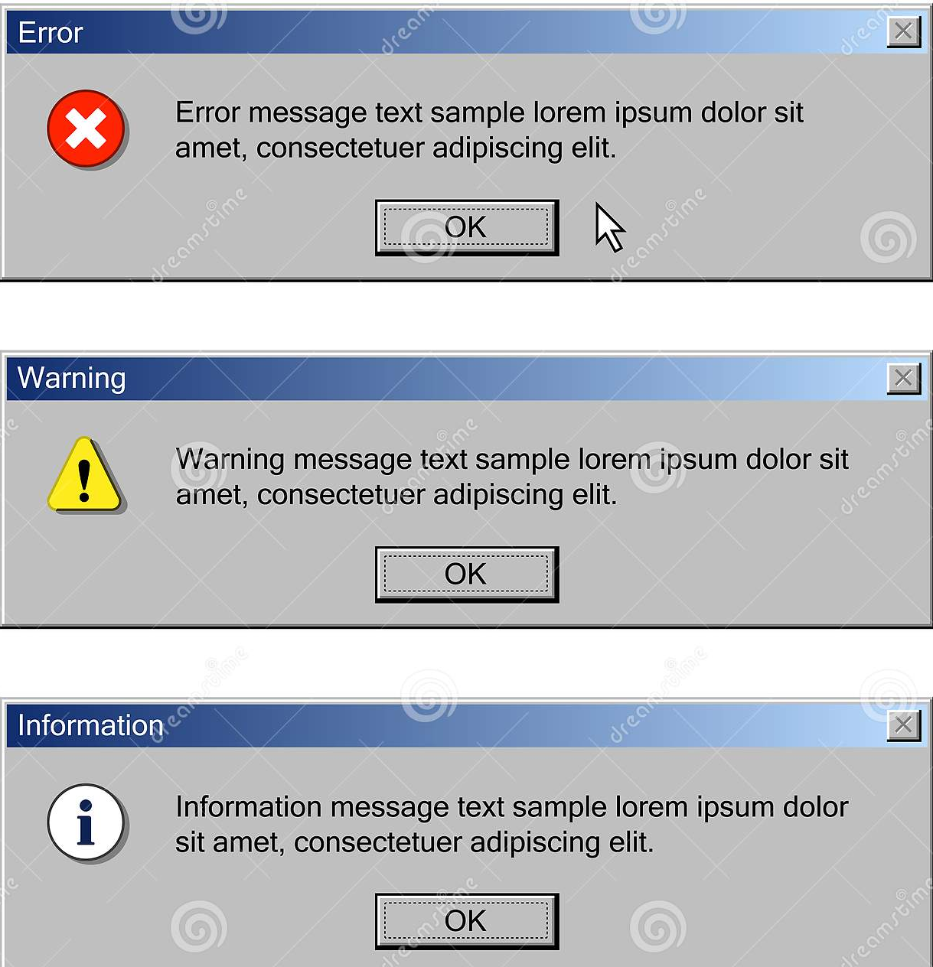
Business cases:
Creation of many similar domain objects (POCO models, DTOs, View Models) like:
Customers
Products
Resources (e.g. in ERP system)
User Story:
In our bank we have a system responsible for monitoring performance, issues, and customer behaviors regarding using our ATMs, mobile application and the main web-page. We want to store in our database feedback from our products such as alerts, warnings, or notifications about bad, good or neutral events. The solution:
store response from our monitoring system as system events (model with defined attributes and behaviors) informing about the problems with the product itself (malfunction, delay, robbery) or user feedback.

Slide 25


Slide 26
Nuances:
Which factory?
Q: Before starting your implementation, you should answer yourself a question what is the pragmatical usage and benefit of the Abstract Factory pattern.
A: For structured problem, when your models derives from each other and their types are known beforehand => choose Abstract Factory
When there is no relation between models, and there is some uncertainty (you do not know the exact types beforehand) => choose Factory Method
How to distinguish object/model types?
Usually there is a convention to use enums, to determine what kind of object you are going to create, e.g.:
var cat = this._animalsFactory.Create(Animals.Cat);
Of course, you can also decide to use: - string - number, etc. However, this solution is prone to typos and requires more effort during code maintenance
Standard naming
One of the implementations of Abstract Factory, is to define in the concrete factory body a Create() method, taking parameter to determine a type of object to be created. And inside of this method, placing switch-case statements returning very spe- cific implementations
Another approach, would be to create dedicated methods: “CreateCat()”, nonetheless this solution is not generic and would cost you a lot of additional effort to add new code and update the existing one

Slide 27
Implementation

Slide 28
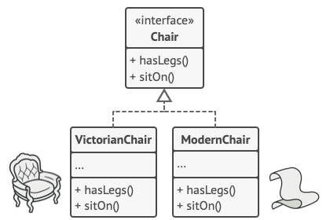
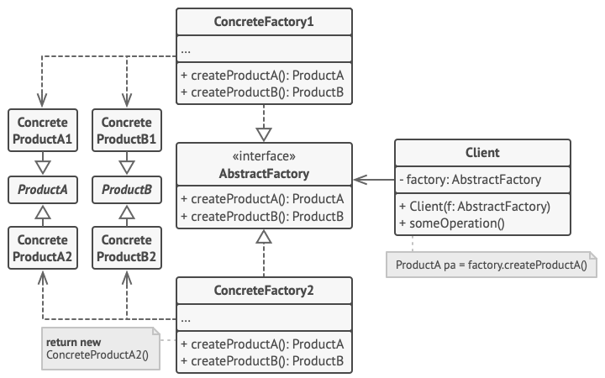
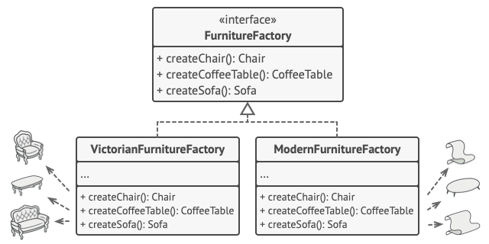
Overview:
1. Models
3. Structure
2. Factory

Slide 29
IMPLEMENTATION
public class Program
{
public abstract class Position
{
public abstract string Title { get; }
}
public class Manager : Position
{
public override string Title
{
get { return "Manager"; }
}
}
public class Clerk : Position
{
public override string Title
{
get { return "Clerk"; }
}
}
public class Programmer : Position
{
public override string Title
{
get { return "Programmer"; }
}
}
}
Comment: You need to support and maintain new cases in switch-case statements as well as prevent errors when unexpected type to create was requested
(e.g. id == 5)
Popular, switch-case:
Can be also a safer enum
public static class Factory
{
public static Position Create(int id)
{
switch (id)
{
case 0: return new Manager();
case 1: return new Clerk();
case 2: return new Programmer();
default:
return new Programmer();
}
}
}
Models:
Printing results:
Factory:
public static void Main(string[] args)
{
for (int i = 0; i <= 2; i++)
{
var position = Factory.Create(i);
Console.WriteLine("Where id = {0}, position = {1} ", i, position.Title);
}
Console.ReadLine();
}

Slide 30
IMPLEMENTATION
public class Program
{
public interface IPosition
{
string Title { get; }
}
public class Manager : IPosition
{
public string Title
{
get { return "Manager"; }
}
}
public class Clerk : IPosition
{
public string Title
{
get { return "Clerk"; }
}
}
public class Programmer : IPosition
{
public string Title
{
get { return "Programmer"; }
} }
}
Comment: In this case using an invalid model type would just not be possible (compilation errors when attempted)
Smart, generic:
public static class Factory
{
public static T Create<T>() where T : IPosition, new()
{
return new T();
}
}
Factory:
Models:
Printing results:
public static void Main(string[] args)
{
IPosition position0 = Factory.Create<Manager>();
Console.WriteLine("0: " + position0.Title);
IPosition position1 = Factory.Create<Clerk>();
Console.WriteLine("1: " + position1.Title);
IPosition position2 = Factory.Create<Programmer>();
Console.WriteLine("1: " + position2.Title);
Console.ReadLine();
}

Slide 31
Interactions with other design patterns:
The concrete implementations of Factories can be sealed as Singletons

Slide 32
CONVENTION:
Using method called “Create()” (with or without parameter)
Using enum parameters or generics
Putting concrete factories into ConcreteFactories folder

Slide 33
2b. Factory Method
CREATIONAL
Characteristic
The purpose of this software design pattern is the same as for Abstract Factory (chapter 2a). The main differences are:
Use case: You do not have predefined / logical inheritance relationship (models)
The scale of impact: This pattern is more compact (smaller, easier) to implement

Slide 34
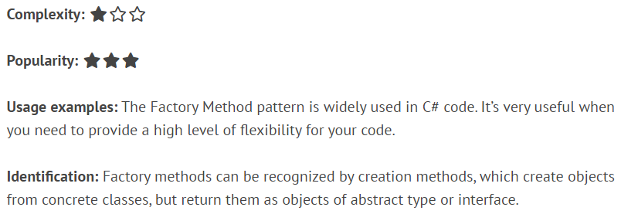
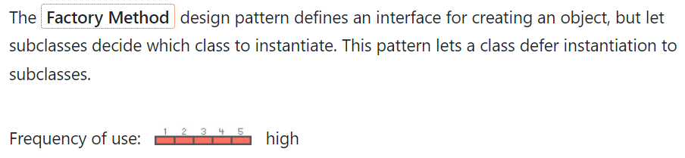
Resources:
https://refactoring.guru/design-patterns/factory-method/
https://refactoring.guru/design-patterns/factory-method/csharp/example/
https://www.dofactory.com/net/factory-method-design-pattern/
https://dotnettutorials.net/lesson/factory-method-design-pattern-csharp/

Slide 35
Implementation

Slide 36
Overview:
Abstract Factory
Method Factory
BaseFactory
IProduct
IProduct
IFactory
protected abstract IProduct Make()
public IProduct Create() => Make()
XYZ_Factory
public IProduct Create<T>()
protected override IProduct Make()
X_Factory
Y_Factory
Z_Factory
X
: IProduct
Y
: IProduct
Z
: IProduct
X
: IProduct
Y
: IProduct
Z
: IProduct
- General usage (one factory but multiple products) - Not specifying which exactly object it will create - To make it work, objects MUST be somehow related
- More specialized (many dedicated factories creating specific items) - Suggests (e.g., by the factory name) which object will be created - Objects can but doesn’t need to be related (attributes, behaviors)

Slide 37
IMPLEMENTATION
public class CatsFactory : AnimalsFactoryBase
{
protected override Animal MakeAnimal()
{
return new Cat("CatName", age: 5, "OwnerName");
}
}
public class MonkeysFactory : AnimalsFactoryBase
{
protected override Animal MakeAnimal()
{
return new Monkey("MonkeyName", age: 2, ZooEnums.Rotterdam);
}
}
public class SlugsFactory : AnimalsFactoryBase
{
protected override Animal MakeAnimal()
{
return new Slug(hasShell: true);
}
}
public abstract class Animal { }
public abstract class AnimalsFactoryBase
{
protected abstract Animal MakeAnimal();
public Animal CreateAnimal()
{
return this.MakeAnimal();
}
}

Slide 38
Interactions with other design patterns:
The concrete implementations of Factories can be sealed as Singletons

Slide 39
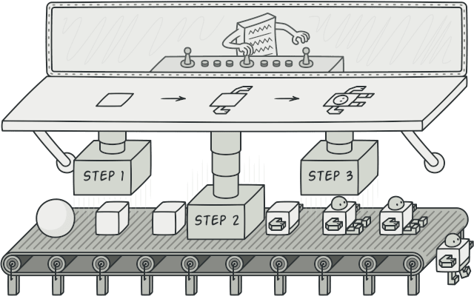
3. Builder
CREATIONAL
Characteristic
Builder allows the user to customize creation of an object much more, splitting the process into (sub-) components than Factory (which is standardized to always produce an object instance in the same way).
Builder is using a couple small helper methods to set up small components of an object before returning prepared object by the main Build() method. Factory is returning a complete object immediately by his Create() method.

Slide 40
The purpose:
Simplify creation of the object: Without resulting in additional code complexity.
For that reason, Builder should provide user-friendly APIs to be used for creating an object (and the alternative ways of creating this object would be advised to remain hidden/restricted):
Private setters
Protected constructor
The Builder should hide unnecessary object creation details from clients as much as possible so that it is easy for them to build the object properly and hard to build the object improperly.
Customize creation of the object: At the same time, there should be various ways how to initialize the object. Unlike Factories, the Builder pattern can create a slightly different objects every time.

Slide 41
Benefits and costs of using:
Pros:
Cons:
+ Customizable: Flexibility to define, toggle, reuse or adjust creation steps used to build a specific type of an object
+ Reusable: Specific creation methods or a group of them can be componentized to be reused among different types of objects and still having the flexibility to customize the creation process
+ Single Responsibility Principle: The process of creation of an object is isolated from the business logic in which this object is / might be engaged
- Complexity: Instead of inline code or private methods placed in one place the user needs to define new classes including classes representing abstract Builder itself and its concrete implementations dedicated to (creation of) specific objects

Slide 42
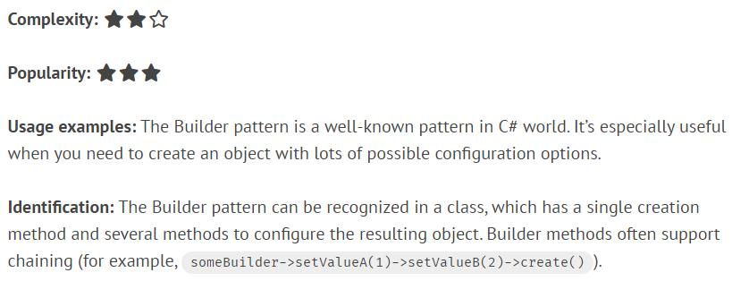
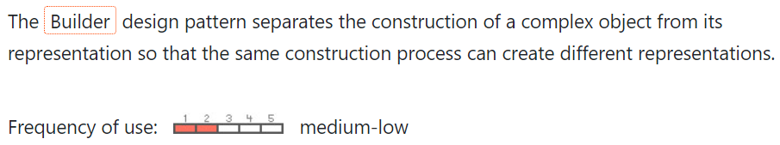
Resources:
https://refactoring.guru/design-patterns/builder
https://refactoring.guru/design-patterns/builder/csharp/example/
https://www.dofactory.com/net/builder-design-pattern
https://endjin.com/blog/2019/06/design-patterns-in-c-the-builder-pattern

Slide 44


Life examples:
Customized handmade toys from Builder (they have similar base but different clothes / colors)
Standardized toys from Factory (all looks the same)

Slide 45
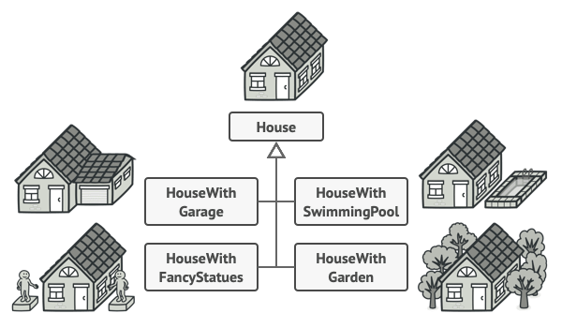

Life examples:
Houses from Builder
Houses from Factory

Slide 46
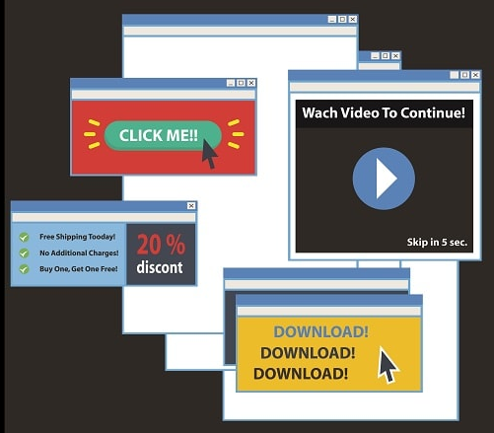
Business Cases:
In the ABC Application user wants to have multiple context menus, popups, and toolbars.
The only common thing for popups is that they are all rectangle and appearing on the center of the screen. Toolbars are above and are horizontally oriented, and context menus will appear on right mouse button click.
That’s all.
Regardless that, they are all different, with different number of buttons, text, colors, icons, tooltips or even conditions when they should be open.
You can fulfill this task by cre- ating multiple UI elements ma- nually, or preparing some private free-floating / utilities / helper methods to change particular as- pects of the UI elements’ content OR you can use Builder pattern to achieve the same result and have everything in one place (some [UIElementName]Builder folder)

Slide 47
Implementation

Slide 48
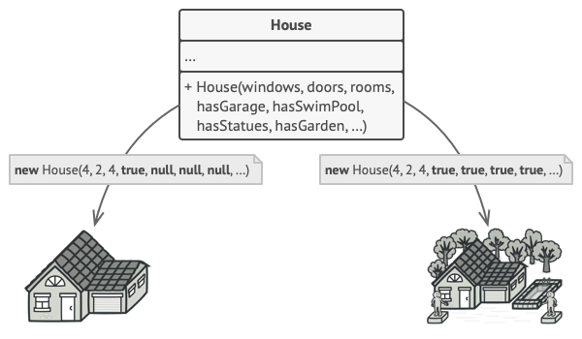
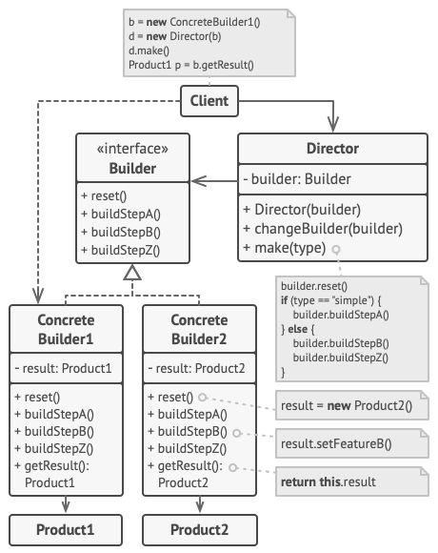
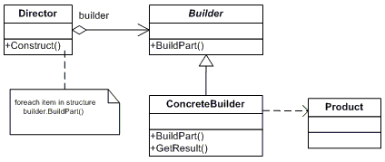
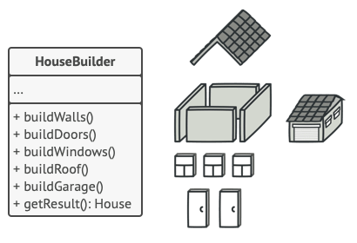
Overview:
To avoid this problem:
We can use Builder pattern:

Slide 49
IMPLEMENTATION
IDEA: Customizing an object is delegated to local specialized methods (check "Strict Builder" to restrict this usage)
(#1a Builder + Properties)
public sealed class BurgerBuilder
{
private readonly Burger _burger = new();
public BurgerBuilder() { }
private void Reset()
{
this._burger.NumPatties = default;
this._burger.Cheese = default;
this._burger.Bacon = default;
}
public Burger BuildCheeseburger()
{
Reset();
this._burger.Cheese = true;
return this._burger;
}
}
public sealed class Burger
{
public int NumPatties { get; set; }
public bool Cheese { get; set; }
public bool Bacon { get; set; }
}
Need to update these properties manually (support for new class features: e.g., "Lettuce")
Usage:
Specialized Builder methods
public static void Main
{
var mcDonalds = new BurgerBuilder();
var cheeseburger = mcDonalds.BuildCheesburger();
}

Slide 50
IMPLEMENTATION
public interface IBuilder<TProduct, TComponent> where TProduct : new() where TComponent : class
{ void Reset();
void AddIngredient(TComponent ingredient);
TProduct Build();
}
IDEA: Using components to boost maintenance
(#1b Builder + Components)
More classes to support.
public abstract class Ingredient { }
public sealed class Cheese : Ingredient { }
NOTE: Using generics is advised
Models:
public sealed class BurgerBuilder : IBuilder<Burger, Ingredient>
{
private readonly Burger _burger = new();
public BurgerBuilder()
{
Reset(); // Default state
}
public void Reset()
{
this._burger.Ingredients.Clear();
this._burger.Ingredients.Add(new Meat());
}
public void AddIngredient(Ingredient ingredient)
{
this._burger.Ingredients.Add(ingredient);
}
public Burger Build()
{
return this._burger;
}
}
public abstract class Food<TComponent> where TComponent : class
{
public List<TComponent> Ingredients { get; } = new();
}
However, if you want to get a specific element from that list, you need to look up inside of it
public sealed class Burger : Food<Ingredient> { }
Specialized Director methods
Usage:
public static void CreateCheesburger()
{
var burger = new BurgerBuilder();
burger = burger.Reset();
burger.AddIngredient(new Cheese());
var cheeseburger = burger.Build();
}
More flexible and generic use case
NOTE: Can be placed in Director class

Slide 51
IMPLEMENTATION
public sealed class ProductABuilder : IBuilder
{
private readonly IPartAService _partAService;
private readonly IPartBService _partAService;
private readonly IProduct _product = new ProductA();
public ProductABuilder( IPartAService partAService, IPartBService partBService)
{
this._partAService = partAService;
this._partBService = partBService;
Reset();
}
public void Reset() // Reset the instance of the product
{
this._product.Parts.Clear();
}
public void BuildPartA()
{
this._product.Add(this._partAService.GetPart());
}
public void BuildPartB()
{
this._product.Add(this._partBService.GetPart());
}
public IProduct GetProduct()
{
var result = this._product; // Cache the customized instance
Reset(); // Reset the object, Builder can now build again
return result; // Return the customized instance
}
}
IDEA: Using generic builders, products, services, and components to achieve the maximum flexibility
(#1c Builder + Services + Collection)
public sealed class Director
{
public IBuilder Builder { get; set; }
public IProduct BuildSimpleVersion()
{
this.Builder.Reset();
this.Builder.BuildPartA();
return this.Builder.GetProduct();
}
public IProduct BuildFullVersion()
{
this.Builder.Reset();
this.Builder.BuildPartA();
this.Builder.BuildPartB();
return this.Builder.GetProduct();
}
}
public interface IBuilder
{
void BuildPartA();
void BuildPartB(); IProduct GetProduct();
}
Usage:
Very flexible approach
Example of using Director class
public interface IProduct
{
void Add(IPart part);
}
However, it’s a massive overhead for simple use cases which does not require such flexibility
public interface IPart { }
public sealed class ProductA : IProduct
{
public IList<IPart> Parts { get; } = new List<IPart>();
public void Add(IPart part) // Aggregate parts
{
this.Parts.Add(part);
}
}
public interface IPartAService
{
IPart GetPart();
}
public interface IPartBService
{
IPart GetPart();
}

Slide 52
IMPLEMENTATION
IDEA: Readability of the code is significantly improved. Object creation looks quite close to a natural English sentence
(#2 Fluent Builder)
public sealed class BurgerBuilder
{
private readonly Burger _burger = new();
public Burger Build() => this._burger;
public BurgerBuilder WithPatties(int num)
{
this._burger.NumPatties = num;
return this; // Return builder
}
public BurgerBuilder WithCheese()
{
this._burger.Cheese = true;
return this; // Return builder
}
public BurgerBuilder WithBacon()
{
this._burger.Bacon = true;
return this; // Return builder
} }
However, this Domain Specific Language (DSL) syntax: this._restaurant.Build(new Burger).WithCheese() .WithBacon(); is also possible to achieve (e.g., extension methods).
Usage:
BurgerBuilder burger = new BurgerBuilder();
Burger baconBurger = burger.WithCheese()
.WithBacon()
.Build();
Very clean and handy approach for simple models. However, imagine using this practice for complex solutions, e.g., with 15 attributes (need to group them, which will increase number of methods even more or reduce the Builder flexibility).
Source: Fluent Builder

Slide 53
IMPLEMENTATION
IDEA: Do not allow building the object before it is properly customized
(#3 Strict Builder)
public sealed class BurgerBuilder
{
private readonly Burger _burger = new(); private readonly BurgerBuilderFinal _final;
public BurgerBuilder()
{
this._final = new BurgerBuilderFinal(this._burger);
}
public BurgerBuilderFinal WithPatties(int num)
{
this._burger.NumPatties = num;
return this._final; // Return builder
}
public BurgerBuilderFinal WithCheese()
{
this._burger.Cheese = true;
return this._final; // Return builder
}
public BurgerBuilderFinal WithBacon()
{
this._burger.Bacon = true;
return this._final; // Return builder
} }
public sealed class BurgerBuilder
{
private readonly Burger _burger = new();
public Burger Build() => this._burger;
public BurgerBuilder WithPatties(int num)
{
this._burger.NumPatties = num;
return this; // Return builder
}
public BurgerBuilder WithCheese()
{
this._burger.Cheese = true;
return this; // Return builder
}
public BurgerBuilder WithBacon()
{
this._burger.Bacon = true;
return this; // Return builder
} }
public sealed class BurgerBuilderFinal
{
private readonly Burger _burger; public BurgerBuilderFinal(Burger burger)
{
this._burger = burger;
}
public Burger Build() => this._burger; }
Usage:
BurgerBuilder burger = new BurgerBuilder();
Burger baconBurger = burger.WithCheese()
.WithBacon()
.Build();
BurgerBuilder
BurgerBuilderFinal
Using "Build()" method is from now on restricted only to modified object
Source: 4 types of Builder

Slide 54
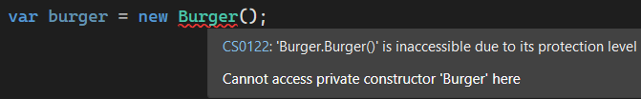
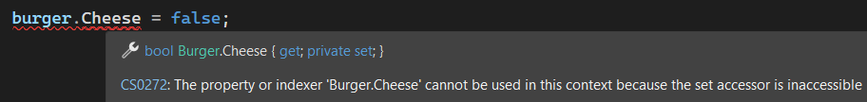
IMPLEMENTATION
IDEA: Fully restricted object creation. Creating an object is possible only through its Builder
(#4 Nested Builder)
In this example: Nested Fluent Builder
public sealed class Burger
{ // Object cannot be modified directly
public bool Cheese { get; private set; }
// Object cannot be created directly private Burger() { } public sealed class BurgerBuilder { private readonly Burger _burger = new(); public BurgerBuilder WithCheese()
{
this._burger.Cheese = true;
return this; // Return builder
} public Burger Build() => this._burger; } }
Usage:
Burger cheeseburger = new Burger.BurgerBuilder()
.WithCheese()
.Build();
Burger class cannot be created or modified explicitly
"Nested Strict Builder" can be used here as well
And then, you will get: "Nested Fluent Strict Builder"… ☺
Source: 4 types of Builder

Slide 55
Interactions with other design patterns:
Builder can be used to simplify overengineered Composite pattern
There is a thin line between both of Factories, Prototype or Builder so, its likely that these designs will be evolving from one to another in your application
You can use Bridge pattern to enhance Builder implementation
The concrete implementations of Builder can be sealed as Singletons

Slide 56
CONVENTION:
Using method called “Build()”
Using the following names of the pattern members:
Director (the manager)
Builder (abstract class or interface)
[XYZ]Builder (concrete builder)
Constructor parameter injection in Director for Builder + public setter to replace it later

Slide 57
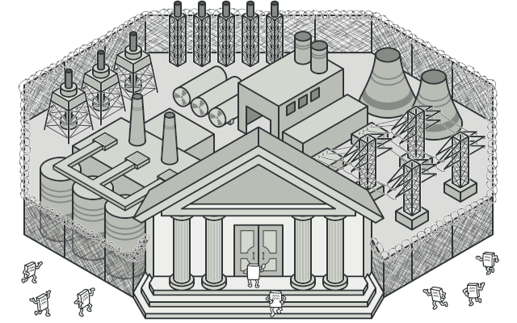
4. FAÇADE
STRUCTURAL
Characteristic
Aggregates, delegates, and isolates a larger and more complex parts of the code into a dedicated, single methods (façades) which would simplify the code usage.

Slide 58
Benefits and costs of using:
Pros:
Cons:
+ Grouping context: You can put into façade an execution chain of other methods (grouping benefit) which are coupled with each other (context benefit) to provide (and ensure) the full business functionality (functional benefit).
+ Make the usage easier: Thanks to that, it is easier to call and reuse business functionalities, since you do not need to remember all required steps, preparations, and dependencies.
+ Delegate: Façade can help in communication between sub-systems and delegation of respon- sibilities (especially useful in microservices and/ or API architectures, with separation of layers)
- Hidden dependencies: While it’s one of the easiest to use among design patterns (“just put everything inside”) can be however quite problematic to implement in a proper way. You need to remember about problem of creating hidden dependencies, providing sufficient documentation, and using meaningful method name (avoid: “Process”, “Do”, “Manage”, etc.). Façade is not a “container for procedural code”.
- Breaking clean code: Improperly designed, naïve, or over- used Façade may dimmish its advantages, especially in light of the fact that this design pattern is violating SOLID princi- ples (especially “Single Responsibility” and “Open-Closed”). In other words: use it wisely, introducing business value to compensate incurred (by definition) vulnerabilities.

Slide 59
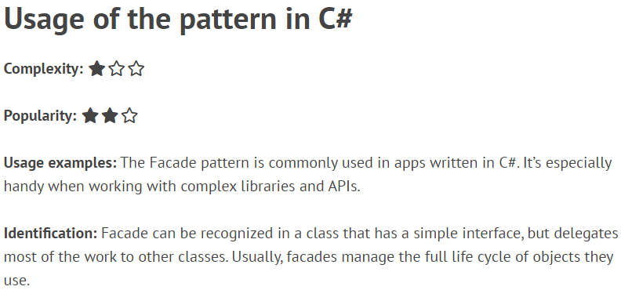
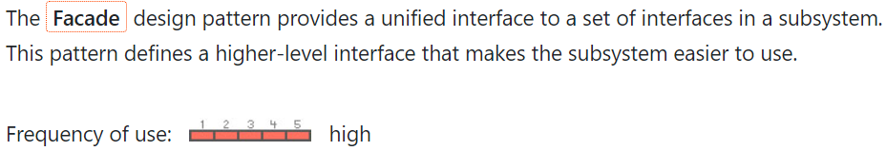
Resources:
https://refactoring.guru/design-patterns/facade/
https://refactoring.guru/design-patterns/facade/csharp/example/
https://dofactory.com/net/facade-design-pattern/

Slide 61

Life examples:
Reception is your only contact with the administration or the office, collecting visitor requests and hiding most of the bureaucracy / actual processes from you

Slide 62

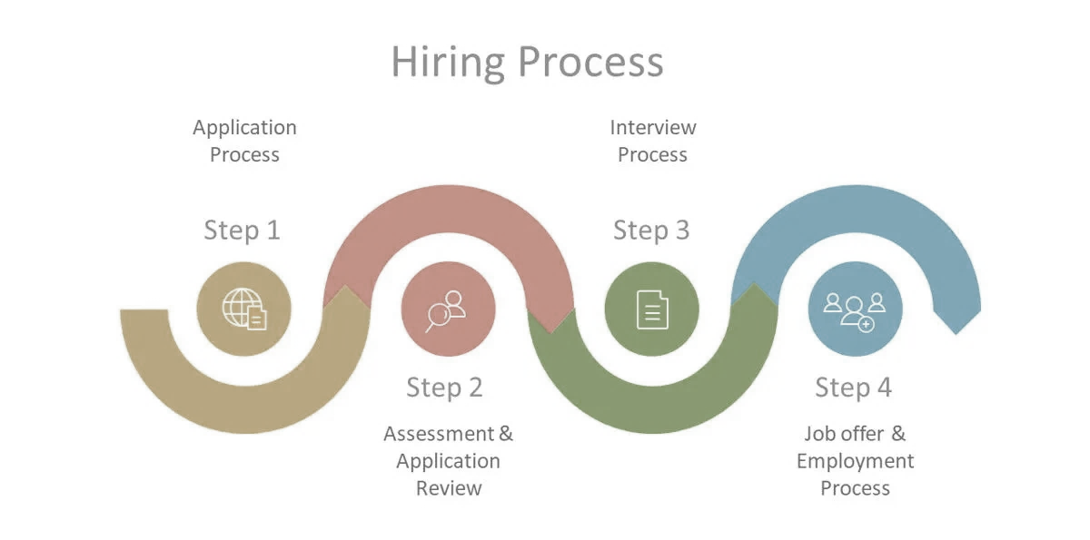
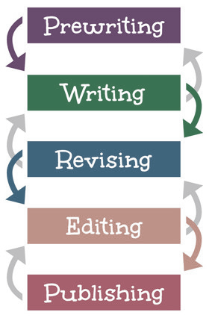
Life examples:
Buttons in machines
Hides complex steps of procedure(s)
Makes the usage a lot easier (for users) by automatizing the whole process
Sometimes, these steps cannot be automated:
uncommon behavior (after an execution of a step an additional reaction should take place (e.g., in response to someone’s feedback),
the order of execution may vary
some steps needs to be executed separately

Slide 63
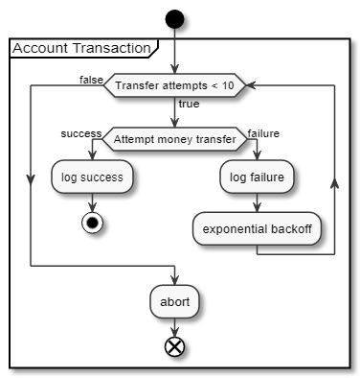

Business cases:
In the past, sending money to someone was more difficult and time consuming. Nowadays, we have bank transfers.
User Story:
Provide safe procedure, where none of the steps cannot be skipped or omitted, to send money funds between bank accounts. The following steps should be included:
- Authentication / checking if user has an account - Asking for transfer data (recipient, IBAN, etc.) - Checking if sender have sufficient funds - Checking if recipient account is existing - Blocking the requested funds (preparation) - Asking for sender’s authorization (e.g., PIN code) - Transferring money (single transaction scope) - Sending confirmations - Registering transaction - Refreshing UI to show new account balance - Sending notifications for sender / and recipient…

Slide 65
Problem with names:
Façade methods are also doing multiple things. Meaningful naming is essential. Try to avoid too generic names, such as: - Process - Calculate - Handle - Manage - Request - Invoke etc.
Describe your method using 2-3 words (ProcessBankTransfer) to summarize its business purpose.
TIP: If you are struggling with making a short and still meaningful name, this may mean your Façade logic is doing too much. Do not hesitate to create smaller Façade methods to split logic

Slide 66
Implementation

Slide 67
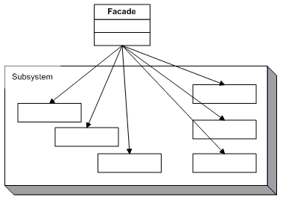
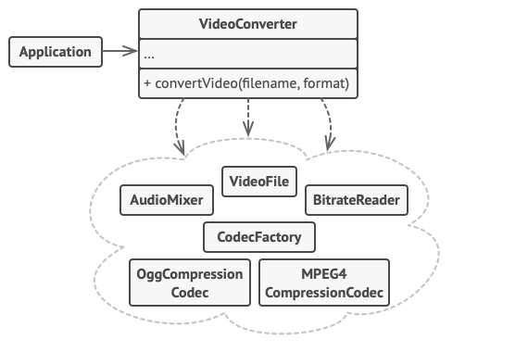
Overview:
Doing a lot of things which are needed to achieve the expected result (asking for help many other classes / services / (sub)systems => e.g., using their APIs)

Slide 68
Façade method
Try to avoid this “naïve” solution:
- remember about the rule to not create hidden dependencies if not absolutely necessary(!)
public class Facade
{
public string GetResult()
{
var service1 = new Service1()
var result1 = service1.Calculate();
var service2 = new Service2()
var result2 = service2.Calculate(result1);
return result2;
}
}

Slide 69

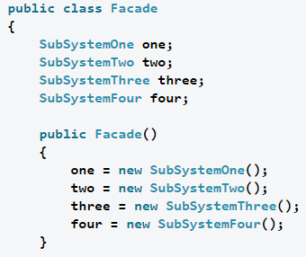
Façade Pattern with Dependency Injection
// The Facade class provides a simple interface to the complex logic of one or several subsystems. The Facade delegates the client requests to the appropriate objects within the subsystem.
public class Facade
{
private protected ISubsystem1 _subsystem1;
private protected ISubsystem2 _subsystem2;
public Facade(ISubsystem1 subsystem1, ISubsystem2 subsystem2)
{
this._subsystem1 = subsystem1;
this._subsystem2 = subsystem2;
}
// Façade methods are shortcuts to execute several steps.
public string Operation()
{
string result = "";
result += this._subsystem1.operationN();
result += this._subsystem2.operationZ();
return result;
}
}
Using DI
Good intention, but still: Hidden Dependencies created

Slide 70
Interactions with other design patterns:
Façade can be used everywhere to extract the larger or more complex blocks of the code
The concrete implementations of Façades can be sealed as Singletons

Slide 71
CONVENTION:
Using constructor dependency injection
Short, but descriptive method naming (usually 2 or 3 words)

Slide 72
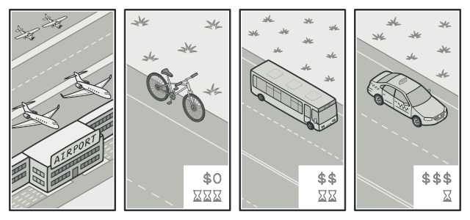
5. Strategy
BEHAVIORAL
Characteristic
When it is possible that depending on a different circumstances a selected part of your application’s behavior should be changed or adjusted, but you want to keep this process simple and automated as possible – to not rewrite the code each time.
When you want to hide (encapsulate) complex and/or very specific behaviors.
When you want to keep your architecture ready (e.g., considering or planning) and flexible in case of introducing a new functionality for a known use case in the future.

Slide 73
Benefits and costs of using:
Pros:
Cons:
+ Functional flexibility: Life can be unpredictable, sometimes you want to stay open and consider multiple alternatives upfront – to avoid surprise.
+ Extendibility: It’s very easy to add new behaviors.
+ Simplify workflow: Even very complex steps can be aggregated into a set of well defined procedu- res to be executed in a specific case. Single entry-point to call a specific business logic.
+ Elegant solution: Avoiding if-else statements.
+ Separation: Clean split between context or data layer and the behavior layer. Good organization.
Hides the behavior: One of benefits can be also a con. If your application is really large it may take you some time to figure out which strategy is currently used and how it is working. Strategy pattern is using overloading, so the specific behaviors are applied in runtime – making them harder to track.
- Awareness: Another consequence of having multiple strate- gies is a need to be aware of their existence. Better under- standing on a deeper and broader level is required.
- Introducing more objects: This is rather standard that design patterns are increasing the number of classes and complexity.

Slide 74
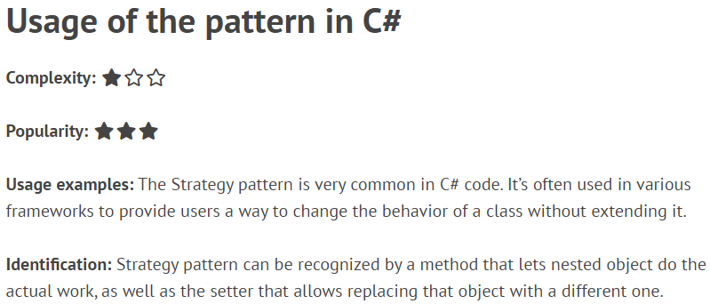
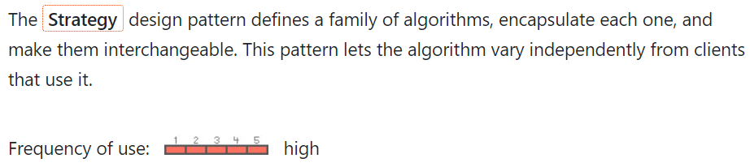
Resources:
https://refactoring.guru/design-patterns/strategy/
https://refactoring.guru/design-patterns/strategy/csharp/example/
https://dofactory.com/net/strategy-design-pattern/

Slide 76




Life examples:
public void Travel(object[] stops);
For a student, the most important aspect of his transportation is the flexibility and low cost
A businesswoman need a higher level of comfort on her way to the office in another country
Good balance between the time saving, com-fort, and profitability can be achieved in large urbanized areas to serve many users
But sometimes “travel” doesn’t literally mean a real, physical act of movement. It can be also an exciting journey in an imaginary world: “characters are going…”

Slide 77





Life examples:
public bool Communicate();
To check if it was received

Slide 78

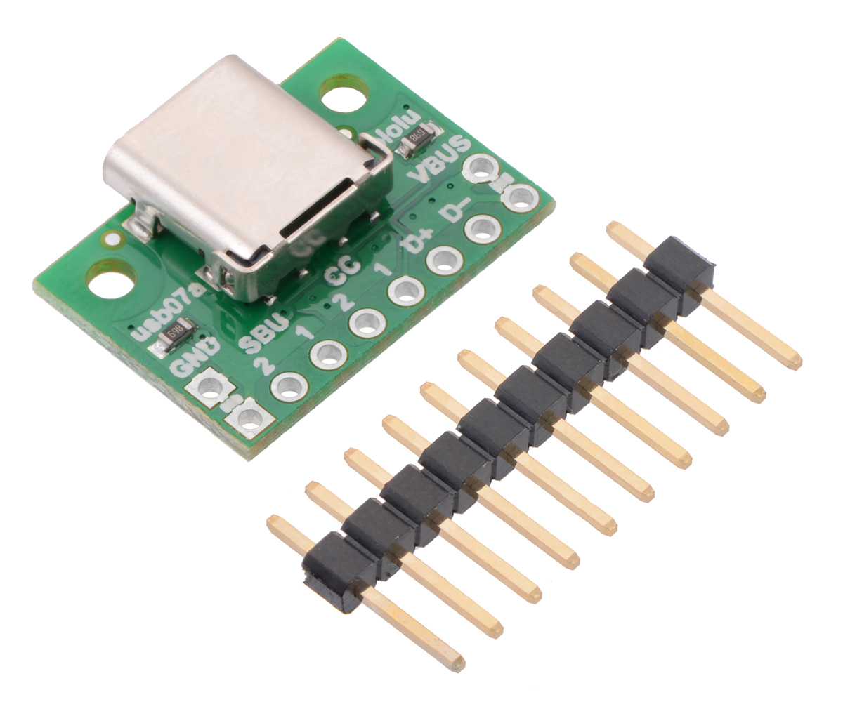
Business cases:
Planning to introduce a few different use cases of a system functionality
User Story:
We are going to produce a new model of mobile phones to debut on the market. According to modern standards we need to support the following scenarios when an USB-C cable is plugged-in to device:
- with power socket: start loading battery
- with power bank: start loading battery and display capacity
- with PC / laptop: ask to browse files
- with digital camera: transfer photos

Slide 79
Implementation

Slide 80
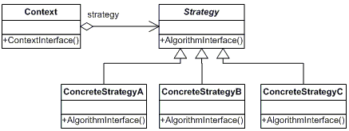
Overview:

Slide 81
Generic version using Dependency Injection
public class Context
{
// The Context maintains a reference to one of the Strategy objects.
// The Context does not know the concrete class of a strategy. It should
// work with all strategies via the Strategy interface
private IStrategy _strategy;
public Context() { } // NOTE: In this case a choice of strategy can be made later
// Usually, the Context accepts a strategy through the constructor, but
// also provides a setter to change it at runtime
public Context(IStrategy strategy)
{
this._strategy = strategy;
}
// Usually, the Context allows replacing a Strategy object at runtime
public void SetStrategy(IStrategy strategy)
{
this._strategy = strategy;
}
// The Context delegates some work to the Strategy object instead of
// implementing multiple versions of the algorithm on its own
public void DoSomething()
{
this._strategy.DoSomething();
}
}
// The interface declares operations common to all supported versions of some // algorithm. The Context uses it to call the algorithm defined by Concrete Strategies
public interface IStrategy
{
void DoSomething();
}
// Concrete Strategies implement the algorithm while following the base
// Strategy interface. The interface makes them interchangeable in the Context
public sealed class WalkingStrategy : IStrategy
{
public void DoSomething()
{
// A + B
}
}
public sealed class DrivingCarStrategy : IStrategy
{
public void DoSomething()
{
// C – B * 3
}
}

Slide 82
Combination with Factory Method
You can decide to automatize the moment of choosing the proper Concrete Strategy
Factory Method design pattern might be especially useful on this step, since (e.g. based on some input) it can decide which strategy will be used in which case
INPUT
IStrategy
Some basic criteria
FACTORY METHOD
CONCRETE STRATEGY
CONTEXT
Decision making
The rest is the same

Slide 83
Combination with FACADE
As an attempt to keep clean and easy to read the implementation of a concrete strategy’s algorithm
It is possible to reuse the Façade design pattern
public sealed class DrivingCarStrategy : IStrategy
{
public void DoSomething()
{
// Multiple steps to be executed
}
}
FAÇADE METHOD

Slide 84
Interactions with other design patterns:
The process of context injection can be handled (determined) by Factory (Abstract or Method)
Larger blocks of code implemented inside the Strategy method can be also extracted into Façades
The concrete implementations of Strategies can be sealed as Singletons

Slide 85
CONVENTION:
Naming the class responsible for taking and caching strategies, and then using their implementations as Context
Using a constructor dependency injection but keeping the possibility to change a con- crete strategy with a public void setter
Putting specific strategies into a ConcreteStrategies folder

Slide 86
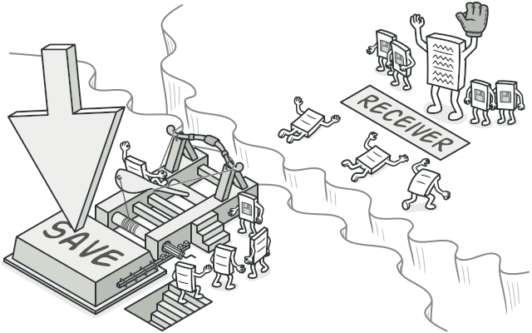
6. Command
BEHAVIORAL
Characteristic
Encapsulates a logic inside of an object. You can „bind” / „subscribe” multiple functionalities to be attached to this object. The whole chain of execution will be released at once when the object will be called. It has multiple implementations (made from scratch, or built-in inside different languages and frameworks => e.g., .NET Events, WPF Commands, ASP.NET “Button.OnClick”, Unity 3D „Button.onClick”, JavaScript actions…

Slide 87
Benefits and costs of using:
Pros:
Cons:
+ Grouping / Queueing: Many functionalities can be put together and assigned into a single object. Determining order of execution is clear and easy.
+ Make the usage easier: As most design patterns, introducing it (preferably early) in the code will make the later usage of functionality much easier.
+ Single Responsibility Principle: Decoupling classes dependencies to perform only specific operations
+ Open Closed Principle: Easy to modify (subscribe)
- A lot of code: Proper implementation made from scratch requires at least 5 different components to be created and involved into cooperation => It’s pretty complex.
+ Covered by many frameworks: But this pattern (and concept) is so handy and frequently used, that many programming lan- guages and software frameworks are already adopted it and exposing this design pattern as/in their own objects or fun- ctions. So, in the end, the native use-case is even handier.

Slide 88
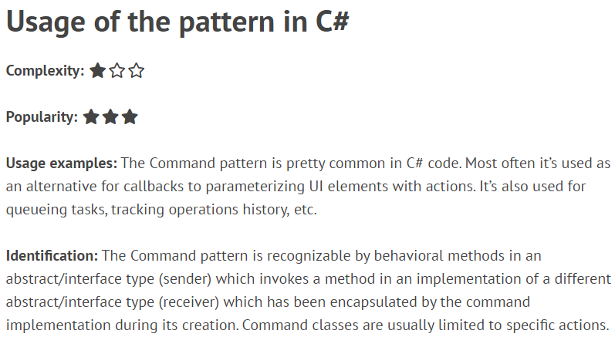
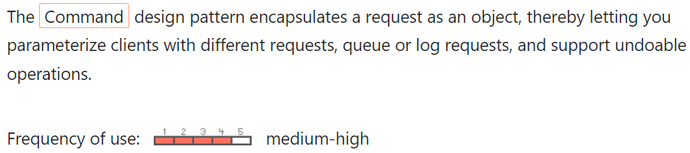
Resources:
https://refactoring.guru/design-patterns/command/
https://refactoring.guru/design-patterns/command/csharp/example/
https://dofactory.com/net/command-design-pattern/

Slide 89
The most popular usages:
User Interface:
Queuing actions:
- Attaching actions to some UI elements like buttons, input fields, scrollers, etc.
NOTE: Very often there is no better or other way how to correlate UI action with backend code than binding/ subscribing server-side methods to client-side elements
- Combining multiple actions into a single trigger, so, all of them will be executed (in a specific order and without need to call them separately)
Action 1
UI Element
Keybinding
Action 2
Stacking actions:
Action 3

Slide 91
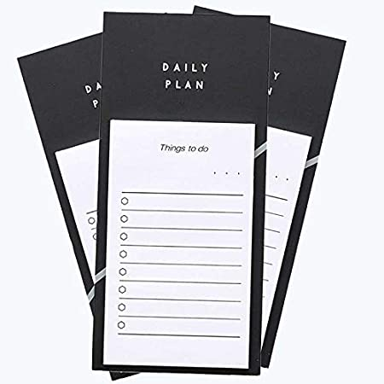


Life examples:
Do not confuse “Command Design Pattern” with commanding someone (giving orders)
Command is an object with some actions that are assigned to it and waiting for a trigger
- A platform to store instructions
- You are writing inside of it steps to be executed later - on demand
- An object is storing functionality
- When picking up this sticky note the process execution is started
- The action is invoked by trigger

Slide 92

Life examples:
Business cases:
Command triggers
Taken from “Software World”
UI Button
The “jumping” feature in a game
Space bar
A good code architecture to make everything generic (so, the action would work for all jumping characters)
Double click (RMB)
Cheat code (CLI)
Jumping command
Gameplay feature
Using the command
Subscription
- Change position of a character
Jumping action
- Display a jumping animation
(This can be a Façade)

Slide 94
Do I need TO reinvent the wheel?
Of course, not!
If your environment is giving you an opportunity to reuse an existing build-in features, then use them freely instead of reimplementing Command Design Pattern literally from scratch

Slide 95
The naming confusion
Depends on the context:
“Object”
Can be a button in your application
Receiver
Is often called an “Action”
Invoker
Is often called a “Trigger”
“Assigning”
Might be also called either “binding”, “subscribing”, “attaching”, “coupling".
Something to object (through command)

Slide 96
Implementation

Slide 97
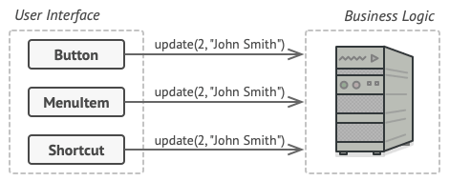
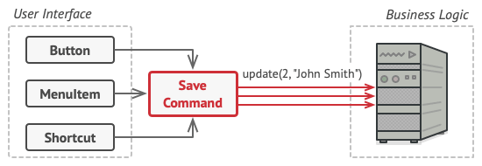
Overview:
The idea behind:
The problem:
The solution:

Slide 98
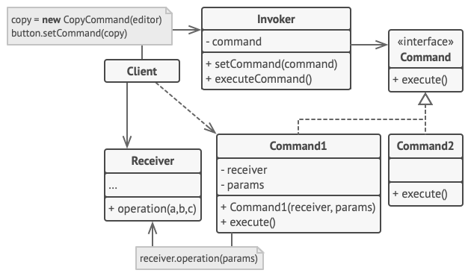
Overview:

Slide 99
Overview:
The layer of abstraction (to create a system of different commands)
public void SetAction(Action action)
BaseCommand
ICommand
public BaseCommand(Action action)
Specific implementation
ConcreteCommand
Stores the relation between an object (e.g., a button) with a specific action
Action
A logic to be used
Binder
Trigger
A place which invoke the specific action
A place where the „relationship” will be created

Slide 100
public sealed class Invoker
{
private Command _command;
public void SetCommand(Command command)
{
this._command = command;
} // This logic can be triggered from outside
public void ExecuteCommand()
{
this._command.Execute();
}
}
Implementation (using class)
public abstract class Command
{
private protected Receiver _receiver;
// Constructor
public Command(Receiver receiver)
{
this._receiver = receiver;
}
public abstract void Execute();
}
public sealed class Receiver
{
public void Action()
{ // In this example it’s just hardcoded
Console.WriteLine("Called Receiver.Action()");
}
}
public class Program
{
public static void Main()
{
// Create receiver, command, and invoker
Receiver receiver = new Receiver();
Command command = new ConcreteCommand(receiver);
Invoker invoker = new Invoker();
// Set and execute command
invoker.SetCommand(command);
invoker.ExecuteCommand();
// Wait for user
Console.ReadKey();
}
}
USAGE:
public sealed class ConcreteCommand : Command
{
// Constructor
public ConcreteCommand(Receiver receiver) : base(receiver)
{
}
public override void Execute()
{
this._receiver.Action();
}
}

Slide 101
public sealed class Invoker
{
private Command _command;
public void SetCommand(Command command)
{
this._command = command;
} // This logic can be triggered from outside
public void ExecuteCommand()
{
this._command.Execute();
}
}
public sealed class Button
{
private Command _command;
public void OnClick(Command command)
{
this._command = command;
} // This logic can be triggered from outside
public void Click()
{
this._command.Execute();
}
}
Implementation (using delegate)
public abstract class Command
{
private protected Receiver _receiver;
// Constructor
public Command(Receiver receiver)
{
this._receiver = receiver;
}
public abstract void Execute();
}
public abstract class Command
{
private protected Action _action;
// Constructor
public Command(Action action)
{
this._ action = receiver;
}
public abstract void Execute();
}
Passing method to the delegate
public class Program
{
public static void Main()
{
// Create receiver, command, and invoker
Command command = new ConcreteCommand(() => Console.WriteLine("Called Button.Action()")); // Void method passed to // internal Action delegate
// Binding part (aka. “subscription”)
Button button = new Button();
button.OnClick(command);
// This can also be also handled by a framework itself
button.Click(); // Click event might occur on UI layer directly
}
}
public class Program
{
public static void Main()
{
// Create receiver, command, and invoker
Receiver receiver = new Receiver();
Command command = new ConcreteCommand(receiver);
Invoker invoker = new Invoker();
// Set and execute command
invoker.SetCommand(command);
invoker.ExecuteCommand();
// Wait for user
Console.ReadKey();
}
}
USAGE:
USAGE:
public sealed class ConcreteCommand : Command
{
// Constructor
public ConcreteCommand(Receiver receiver) : base(receiver)
{
}
public override void Execute()
{
this._receiver.Action();
}
}
public sealed class ConcreteCommand : Command
{
// Constructor
public ConcreteCommand(Action action) : base(action)
{
}
public override void Execute()
{
this._action(); // Shorter than “this._action?.Invoke();”
}
}

Slide 102
Interactions with other design patterns:
If you want to bind different commands (to triggers) depends on circumstances you can consider Strategy workflow
The process of creating commands in case you have some abstraction may be defined in command Factory
The process of assigning commands (binding) can be delegated into a specific methods of Builder
More complex functionalities from commands can be handled by Façades

Slide 103
CONVENTION:
More often case is to use constructors for commands to pass actions inside
Creating command and assigning / binding action to it is happening in the same place (class or method scope)

Slide 104
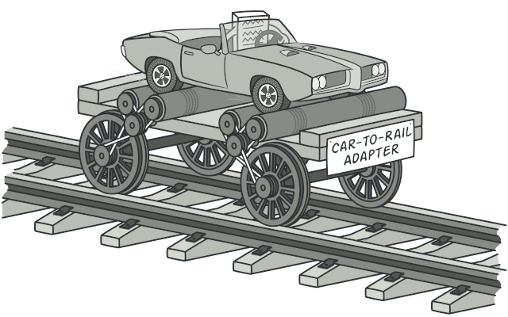
7. Adapter
STRUCTURAL
Different interface or signature
Characteristic
Introducing a necessary communication “switch” / “extension”, for components of the system which were not designed to collaborate with each other (on the day when they were developed). The mentioned trick is used mostly with parts of legacy solution, since they cannot be modified anymore. New components which are not matching the existing interface (or does not use one) should be just refactored to do so.
It is also possible to use it with complex systems based on many dependencies

Slide 105
Benefits and costs of using:
Pros:
Cons:
+ Single Responsibility Principle: Extracting certain behaviors into a dedicated interfaces to manage and group them respectively
+ Open/Closed Principle: Using adapters, you do not need to change the previously existing code structure, contracts, implementations
- Additional complexity: By introducing adapters you need to bear in mind about existence of an additional communication layer – which might not be obvious when looking at the code for the first time or after a while. That’s why it is recommended to use adapters only for legacy code which cannot be changed that easily, but to invest time in code refactor (contracts, generics) in case of the new code which can still be modified
Solving bad design by introducing adapters can be perceived as an antipattern and should be avoided in favor of refactor

Slide 106
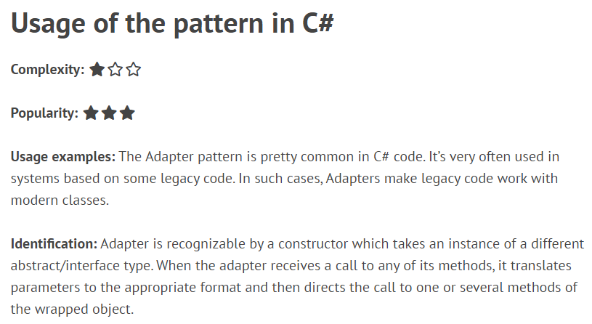
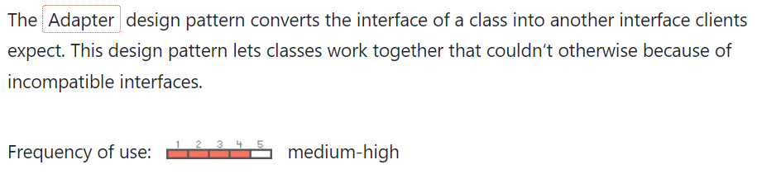
Resources:
https://refactoring.guru/design-patterns/adapter/
https://refactoring.guru/design-patterns/adapter/csharp/example/
https://dofactory.com/net/adapter-design-pattern/
https://endjin.com/blog/2020/10/design-patterns-in-csharp-the-adapter-pattern

Slide 108



Life examples:
Adapter is not (should not) changing behavior of an object, just enables to connect it with an incompatible part of some existing system

Slide 109


Integrate an interface/or interface-less class of an older payment system, to start using PayPal token-based authentication method
Business cases:
You cannot reimplement or change the currently working part of the software because it is too fragile and important
However, we still want and need to enhance it’s functionality (added by another interface)

Slide 110
Implementation

Slide 111
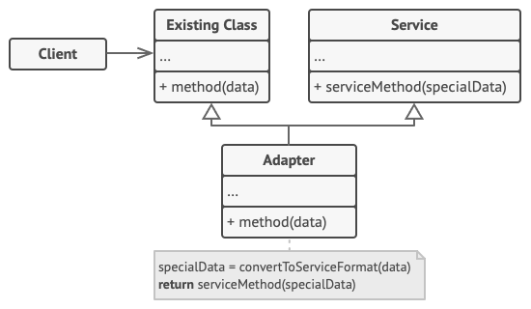
Adapter is working on two ways: - converting data from A to B (to match signatures) - changing signatures (if a behavior is too different)
Overview:

Slide 112
Relations with other design patterns:

Slide 113
Implementation
public sealed class Cat : IAnimal
{
public override string GetName(int age)
{
return $"{nameof(Cat)}: {age}";
}
}
public sealed class Dog
{
public string GetName()
{
return nameof(Dog);
}
}
Adapter is changing the original method / interface of the class
public sealed class DogAdapter : IAnimal
{
private Dog _dog;
// Constructor
public DogAdapter(Dog dog)
{
this._dog = dog;
}
public override string GetName(int age)
{
return $"{this._dog.GetName()}: {age}";
}
}
animal = new Dog();
// Compilation error (not implementing interface)
dogName = animal.GetName();
// Data discrepancy (name will not contain age)
IAnimal animal = new Cat();
string catName = animal.GetName(5);
// Output: "Cat: 5"
animal = new DogAdapter(new Dog());
string dogName = animal.GetName(7);
// Output: "Dog: 7“
Enhancing behavior of Dog class
This is the “side effect” (see cons section) when using adapters

Slide 114
CONVENTION:
Prefer refactor if possible. Consider adapter only if you have no other choice (legacy)
When implementing adapters use dependency injection (constructor or property) and avoid creating new, hardcoded ones
Using word “… Adapter” in class name

Slide 115
8. Decorator
STRUCTURAL
Can fly
Can walk
Enhanced interface or signature
Characteristic
It allows attaching new behavior to an already existing object (without modifying this object internal implementation – Open/Closed Principle). The way to achieve this result is to place source object (with A behavior), inside a special wrapper class (which is exposing additional B behavior).

Slide 116
Benefits and costs of using:
Pros:
Cons:
+ Single Responsibility Principle: Each wrapper can be responsible for a single behavior
+ Open/Closed Principle: When using decorator, the programmer can keep the already existing implementation unchanged, and extending the new behaviors by adding more wrappers
+ Adding/Removing behaviors of an object (adding – using new wrapper around object, removing – using narrower/no wrapper)
+ Stacking behaviors from different wrappers
- Additional complexity: You need to create additional objects: “wrappers”, which are containing additional logic. More complex your idea / intention is going to be, the more objects you need, and relationships between them can be also complex. For example, you can build either a chain of inheritance, WalkingObject => SwimmingObject => FlyingObject => …
or a composition of behaviors placed in a smaller amount of wrappers (less SRP) but then unable to decouple them.
- Difficult to implement order-independent decorator
- Difficult to manage wrappers stack (A => B => C => D)
OperationA(); OperationB(); OperationC();

Slide 117


Resources:
https://refactoring.guru/design-patterns/decorator
https://refactoring.guru/design-patterns/decorator/csharp/example/
https://www.dofactory.com/net/decorator-design-pattern
https://endjin.com/blog/2020/10/design-patterns-in-csharp-the-decorator-pattern

Slide 119



Life examples:
Basic card, used to pay in shops
When put inside the RFID cover the card is gaining anti-scanning property
When additionally put into a wallet the card will gain anti-bend and anti-broken benefits. Also, it’s harder to be spot and stolen

Slide 120

By adding more layers of specialized clothes we are gaining a level of weather protection, e.g.; cold-proof, wind-proof, water-proof…
Life examples:

Slide 121
Integrate an interface/or interface-less class of an older payment system, to start using PayPal token-based authentication method
Business cases:
You cannot reimplement or change the currently working part of the software because it is too fragile and important
However, we still want and need to enhance it’s functionality (added by another interface)

Slide 122
Implementation

Slide 123

Overview:
Decorator extends the behaviors of component

Slide 124
Relations with other design patterns:

Slide 125
Implementation
Concrete class
public interface IAnimal
{
string Action();
}
Decorator definition
public sealed class Dog : IAnimal
{
public override string Action()
{
return “woof woof”;
}
}
public sealed class AnimalDecorator : IAnimal
{
private IAnimal _animal;
public AnimalDecorator(IAnimal animal)
{
this._animal = animal;
}
public override string Action()
{
return this._animal.Action();
}
}
Bark
Concrete decorator A
We are not changing Action() method or interface but enhancing its functionality
public sealed class AngryDog : AnimalDecorator
{
public AngryDog(IAnimal animal) : base(animal) { }
public override string Action()
{
Bite();
return base.Action();
}
private void Bite() { // something here }
}
Concrete decorator B
public sealed class PoliceDog : AnimalDecorator
{
public PoliceDog(IAnimal animal) : base(animal) { }
public override string Action()
{
SniffDrugs();
return base.Action();
}
}
new Dog());
Bite
var wildDog = new AngryDog(new Dog());
var wildDog.Action(); // Bark + Bite
var policeDog = new PoliceDog(new AngryDog());
var policeDog.Action(); // Bite + Sniff
Sniff
+ Bark

Slide 126
CONVENTION:
Preference of constructor injection public Decorator(Source source) { } it’s possible to leave an additional setter (to change the internal reference later): public void SetSource(Source source) { }
Using word “…Decorator” in class names

Slide 127

9. Proxy
STRUCTURAL
Substitutes interface or signature
Characteristic
Provides an object which acts like a substitute / surrogate or a placeholder for another object or a concrete service. A proxy controls access to the original object / service, allowing you to perform some work (caching, calculating, etc.) either before or after the request gets through to the original object.
Proxy offers remote access or adding an extra level of protection around the object. The proxy pattern can be used to restrict access to an object, to provide a simpler or lightweight interface or to allow a client communication with a remote object.

Slide 128
Benefits and costs of using:
Pros:
Cons:
+ Control: of the service / object
+ Manage: the lifecycle of the service / object
+ Open/Closed Principle: new proxies can be introduced without changing the code of the original service / object
- Additional complexity: more classes needs to be introduced
- Delayed response: because proxy is a wrapper around the original service / object, the response from them might be slightly delayed (request is passing through proxy first and the response needs to be also read by proxy afterwards)

Slide 129


Resources:
https://refactoring.guru/design-patterns/proxy
https://refactoring.guru/design-patterns/proxy/csharp/example/
https://www.dofactory.com/net/proxy-design-pattern
https://endjin.com/blog/2020/12/design-patterns-in-csharp-the-proxy-pattern

Slide 131

Life examples: (business is the same)
And bank account is also a Proxy for a physical pile of paper cash
A bank card is Proxy (substitute) of your bank account (real service)
You do not need to operate on real money if you have a bank account. But again, bank account is only a placeholder, it does not represent a real value of the original service (cash) without this service. No money => zero purpose of having a bank account
Which means, you are using your bank card instead of direct operations from the bank account. But the card is just a wrapper (it means nothing without the real service – bank account)

Slide 132
Implementation

Slide 133

Overview:
External service or app using the internal service
Interface
A service substitute (the place which will be engaged first before sending any request to the real internal service)
Real internal service
A request to do some work by the real service

Slide 134
Relations with other design patterns:

Slide 135
public interface IAnimal
{
string MakeSound();
int GetMaxLivingAge();
}
Implementation
Examples of Proxy actions executed before/after passing the request to the service:
Service / Object (substitute
public abstract class Bird : IAnimal
{
public abstract string …
}
public sealed class BirdProxy : IAnimal
{
private readonly IAnimal _bird;
public CanaryProxy(IAnimal bird)
{
this._bird = bird;
}
public override string MakeSound()
{
return this._bird.MakeSound();
}
public override int GetMaxLivingAge()
{
return this._bird.GetMaxLivingAge();
}
}
private bool IsValidBird(IAnimal animal)
{
return animal is Bird && // Not a bird!
animal is Canary; // Invalid bird
}
Service / Object (real)
private bool Logging(Action action)
{
try
{
action?.Invoke();
}
catch (Exception exception)
{
this._logger.LogError(exception);
}
}
public sealed class Canary : Bird
{
public override string MakeSound()
{
return "Chirp chirp";
}
public override int GetMaxLivingAge()
{
return 10;
}
}
Request to the service
private void LogResult()
{
this._logger.LogInfo("Success");
}
Request to the service
NOTE: Introduce variable and return it later

Slide 136
CONVENTION:
Preference of constructor injection public Proxy(Source source) { } it’s possible to leave an additional setter (to change the internal reference later): public void SetSource(Source source) { }
Using word “…Proxy” in class names

Slide 137

10. Iterator
BEHAVIORAL
Characteristic
Allows to walk through (traverse) over a collection of elements.
This design pattern is an absolute must-have in case of custom collections which do not have their own iterators (graphs – trees, tries, custom linked lists; custom specialized collections (filtering out or validating results, adding observable features, etc.); heaps; multidimensional arrays – matrixes, jagged arrays, nested arrays) or custom operations such as reversed iteration, step iteration…

Slide 138
Benefits and costs of using:
Pros:
Cons:
+ Single Responsibility Principle: You are extracting traversal strategies into a separate class or folder structure, not polluting the business logic code, where the custom collection is used.
+ Open / Closed Principle: You can add more traver- sal strategies, since you will be still using the same iterator interface. Code doesn’t need to be upda- ted. You can also still add new types of collections.
+ Task-based iteration: Each iterator can be instantia-ted separately (if singleton is not in use), which means you can use a couple of different iterators on the same collection at the same time.
No cons*
Do not use iterator on built-in (simple) collections. Reason: Your implementation, almost for sure, will be less efficient than a .NET built-in, optimized solution.
Do not create custom collections which are doing the same thing (probably less efficiently) as .NET specialized collections. Pick data structures wisely from beginning. Reason: You will end up with less reliable collection, using a custom (less efficient) iterator => an overkill.

Slide 139


Resources:
https://refactoring.guru/design-patterns/iterator
https://refactoring.guru/design-patterns/iterator/csharp/example/
https://www.dofactory.com/net/iterator-design-pattern

Slide 141




Life examples:
Reading order: 1. Left to right, 2. Top to bottom
Reading order: 1. Right to left, 2. Top to bottom

Slide 142



Business cases:
For some reason you had to implement a custom dictionary which is not allowing duplicates but does not throw exception when the key is already existing (normal dictionary is throwing an exception). Moreover, this dictionary should publish an event when the collection was modi- fied by Create, Update or Delete opera- tion, to simulate “observable” behavior.
However, there is no built-in iterator over this type of custom collection. You need to provide your own iterator then…

Slide 143
Implementation

Slide 144



Problem:
For iteration:
Starting from index i, moving to index i + 1
Foreach iteration:
Starting from head moving till “next” exists
?
Graph iteration:
?
???

Slide 145


Problem:
More than one solution
DFS (Depth-First Search)
BFS (Breadth-First Search)

Slide 146

Problem:
More than one solution
Different traversal strategies used on demand

Slide 147

Overview:
Interface used by all custom iterators
Interface used by all custom collections
Needs to use IIterator
Concrete implementation of custom iterator
Concrete implementation of custom collection

Slide 148
public interface IIterator<T> : IEnumerator<T>, IDisposable
{
object Current();
T MoveNext();
}
public sealed class CustomIterator<T> : IIterator<T>
{
private readonly IEnumerator<T> _collection;
public CustomIterator<T>(IEnumerable<T> collection)
{
this._collection = collection.GetEnumerator();
}
public T Current()
{
return this._collection.Current;
}
public bool MoveNext()
{
if (this._collection != null)
{
if (this._collection.MoveNext())
{
return true; // Now, you need to use Current()
}
Dispose();
}
return false;
}
public void Dispose()
{
this._collection?.Dispose();
}
}
Implementation
NOTE: This is only a conceptual example. Writing custom iterator for built-in List is completely redundant.
Required by IEnumerator
Usage:
public static void Main()
{
// Collection
var numbers = new List<int> { 1, 2, 3, 4, 5 };
// Iterator
var iterableNumbers = new CustomIterator(numbers);
// Iterating not over “numbers” but internal “_collection”
foreach (var number in iterableNumbers)
{
Console.WriteLine(number);
}
}
However, you can implement this method in a way to iterate over a given collection in a reversed order or skipping every 2nd value

Slide 150
Ienumerator Methods:
Foreach is nothing else than just a “syntax sugar” to use iterator associated with a given collection in a more convenient way than for (even, if there is no index structure behind and for is not allowed)
1. GetEnumerator() method is called on a given collection
2. MoveNext() method is called from retrieved IEnumerator If bool MoveNext() method will return false, then the loop will be terminated
foreach (var item in items)
{
// Some operation on “item”
}
Foreach is using IEnumerator methods (Current, MoveNext).
IEnumerator is an interface used by those IEnumerable collections which can be iterated through
3. Current property of retrieved IEnumerator is peeked now The recently browsed element will be returned and assigned to internal var- iable (that’s why we are declaring var- iables inside of the foreach loops)
4. Depends on the true/false state of MoveNext() method the loop will continue or not

Slide 151
Interactions with other design patterns:
Memento design pattern would allow to preserve the current iteration state in case of rolling it back a bit later
Using Visitor design pattern and additional operation can be executed on the currently iterated element (regardless it’s type)
You can use Factory Method or Strategy to control which custom iterator should be used with a specific custom collection

Slide 152
CONVENTION:
Always implement the most basic methods like Count(), GetEnumerator(), MoveNext(), Current(), Clear(), ToString(), to ensure that custom iterator (wrapper) class will behave like a real collection – not only in foreach.

Slide 153

11. Observer
BEHAVIORAL
Characteristic
Notify others when a state of an object was changed.
This pattern allows to create a one-to-many relationship between observed (publisher) object and its observers (subscribers) that are going to be notified as soon as the state of the observed object is changed.

Slide 154
Benefits and costs of using:
Pros:
Cons:
+ Open Closed Principle: Possible to introduce new subscribers without changing anything on the publisher state. Independency
+ Clean way of propagating states: Creating many subscribers to listen one publisher. Objects that are not subscribing to publisher are not affected
+ Creating relations between objects in real-time: you can Subscribe or Unsubscribe anytime; this connection does not need to be predefined as a classical inheritance/usage OOP relationship
- Fire and forget: Subscribers will be notified in a hard to predict order

Slide 155


Resources:
https://refactoring.guru/design-patterns/observer
https://refactoring.guru/design-patterns/observer/csharp/example/
https://www.dofactory.com/net/observer-design-pattern

Slide 157



Life examples:
Observers: 0
Observers: 1
“Let me know when the cake is done”
Observers: 2
“Let me know when the cake is done”
“Yes, I want to try the cake as well”

Slide 158


Business cases:
The source of news in app => push notification recipients
Subscribing to a newsletter
The technology of webhooks

Slide 159
Implementation

Slide 160


Overview:
The idea behind: Simultaneous and effortless update
2. Sending / receiving update
1. Subscribing

Slide 161

Overview:

Slide 162
PUBLISHER
public interface IInvestor
{
void Update(Stock stock);
}
Implementation
public abstract class BaseStock
{
public string Symbol { get; } private double _price;
public double Price { get => return this._price; set { // NOTE: Notify if price changed if (value != this._price) { this._price = value; Notify(); } } }
private List<IInvestor> _investors = new();
// Constructor
public BaseStock(string symbol, double initPrice)
{
this.Symbol = symbol;
this.Price = initPrice;
} // Methods }
SUBSCRIBER
public sealed class Investor : IInvestor
{
private readonly string _name;
public Stock Stock { get; set; }
// Constructor
public Investor(string name)
{
this._name = name;
}
public void Update(Stock stock)
{
Console.WriteLine($"Stock \"{stock.Symbol}\"
changed price: \"{stock.Price}\"");
} }
public sealed class Stock : BaseStock { }
public void Attach(IInvestor investor)
{
this._investors.Add(investor);
}
public void Detach(IInvestor investor)
{
this._investors.Remove(investor);
}
public void Notify()
{
foreach (var investor in this._investors)
{
investor.Update(this);
}
}
USAGE:
// Initialization var cocaCola = new Stock("KO", 62.5); var investor = new Investor("Monica"); cocaCola.Attach(investor); // Subscribing cocaCola.Price = 64.0; // Monica was notified

Slide 163


Interactions with other design patterns:
Alternatives for Observer to connect senders with receivers are: Chain of Responsibility, Command, Mediator
Mediator and Observer are very similar and can be used interchangeably or simultaneously (like Builder / Factory)
The concrete implementations of Publishers and Listeners can be sealed as Singletons

Slide 164
CONVENTION:
Using methods such as: Subscribe() / Attach() Unsubscribe() / Detach()
The observed class to be called …Publisher
The observing classes to be called …Listener

